Slide 1
AI/ML Subspace-Based Parameter Estimation MPI Workshop 2025
Al Samuel, Pranav Prabhakaran Sudha, Kevin Bongiovanni
6/9/2025

Slide 2
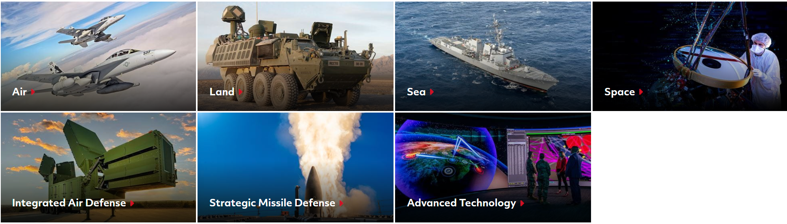
About Us: Raytheon Technologies (RTX)
Three main business units
Collins Aerospace
Specializes in advanced structures, avionics, interiors, mission systems, etc that serve the commercial, regional, business aviation and military sectors.
Pratt & Whitney
Designs, manufactures, and services advanced aircraft engines and auxiliary power systems for commercial, military and business aircrafts.
Raytheon
Design, development, manufacturing and sustainment concentrations in weapons, defense systems, and military and commercial electronics.
67K+ Employees, 28K+ Engineers
Team spread across 58 countries
Worlds largest producer of guided missiles.
Raytheon Capabilities
RTX Is A Global Provider Of Commercial And Defense Solutions

Slide 3

Description/Overview of Problem
Subspace based parameter estimation techniques, specifically Direction of Arrival Estimation (DoA), are well understood and prominent in signal processing.
Techniques include MUSIC, ESPRIT, and Matrix Pencil algorithms
Exploit inherent orthogonality that exists between noise subspace and signal vectors that span the (signal+noise) subspace
Noise subspace-based projection matrices are used by algorithms
AI/ML approaches have been developed that derive surrogate matrices which behave like noise subspace-based projection matrices.
A brief analysis showed that these surrogate matrices behave like an interesting cross between beamforming and noise subspace projection matrices.
These surrogate matrices may serve as a basis for developing virtual sensor concepts.
Understand Properties of AI/ML Surrogate Matrices and Potentially Develop Additional Surrogates

Slide 4


Goals for Problem Solvers
Goal 1: Characterize AI/ML Surrogate Matrix
Goal 2: Derive Additional Surrogate
Matrices
Develop an understanding of its mathematical properties
Identify relations to MUSIC noise subspace or MVDR inverse matrix.
Determine how surrogate matrix is able to demonstrate enhanced behavior
Exploit and enhance any understood principles of the AI/ML surrogate matrix.
Leverage surrogate matrices to develop virtual sensor concepts that provide enhanced degrees of freedom
Deeper Understanding of AI/ML Surrogate Matrix Bolsters Confidence in Solution

Slide 5

Overview of Presentation
Discussion Topics
Antenna Arrays and Correlation Matrices
Direction of Arrival Estimation
Conventional Beamforming
MVDR
MUSIC
Subspaces and Orthogonality
Eigendecomposition
Neural Networks for DoA Estimation
Model-Based Networks
COSnet
Revisit Problem Statement
Provided Data

Slide 6
Antenna Arrays and Correlation Matrices

Slide 7
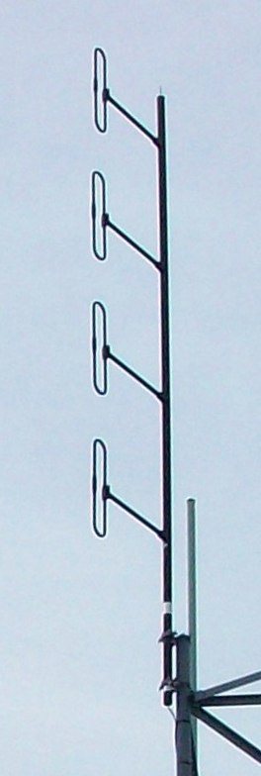
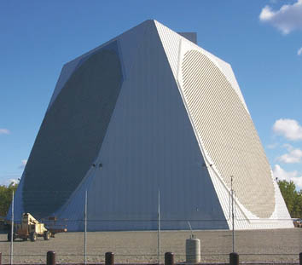
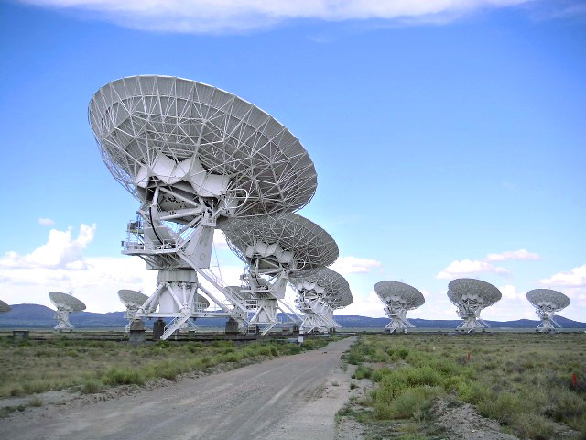
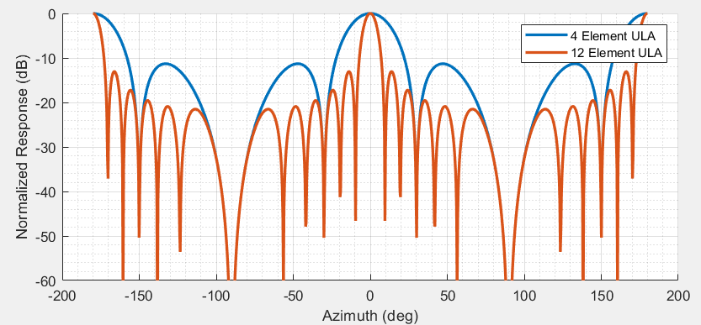
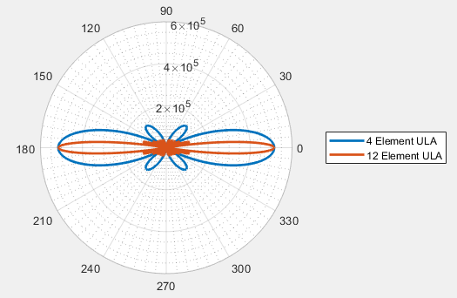
Antenna Array: The What and Why
Example of Antenna Arrays
A set of multiple connected antennas (sensors/elements) that work together as a single antenna.
Why Use an Antenna Array?
Provides Directivity
Achieves Higher Gain
Allows for Direction Finding
Linear Folded Dipole Antenna. Omnidirectional in azimuth (horizontal) but directive in elevation (vertical). Used for dispatch services.,
PAVE PAWS (Phased Array Warning System), a complex Cold War early Warning Radar System developed in 1980 utilizing a pair of Raytheon AN/FPS-115 phased array radars, each having 2,677 antenna elements.
The Very Large Array (VLA) Y-shaped array of 27 Dish Antennas. Built by National Radio Astronomy Observatory in Socorro, New Mexico for astronomical observations.
Cartesian Plot
Polar Plot
Normalized Antenna Patterns for ULAs
Sidelobes
Mainlobe
Antenna Arrays are Critical for RF Direction Finding

Slide 8

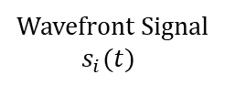
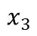
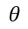
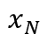
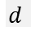
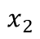
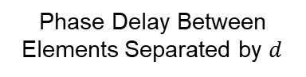
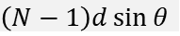
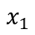
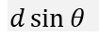
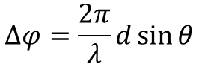
Antenna Array: The Importance of Phase Delay
Incidence of Received Wavefront On Antenna Array
The received signal will vary in phase across an array
The phase difference between elements is due to a difference in propagation length
and can be related to the angle of incidence
Estimating the rate of change in phase indicates the Direction of Arrival (DoA) of the signal.
Wavefront Signal
$$s_{i}(t)$$
$$\left(N−1\right)d\sin{θ}⁡$$
$$d\sin{θ}⁡$$
$$θ$$
$$…$$
Antenna Array
(aperture)
$$d⁡$$
$$x_{1}$$
$$x_{2}$$
$$x_{3}$$
$$x_{N}$$
Phase Delay Between Elements Separated by $d$
$$∆φ=\frac{2π}{λ}d\sin{θ}$$
The Phase Delay Between Elements is Related to The Direction of Arrival

Slide 9
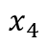
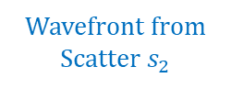
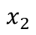
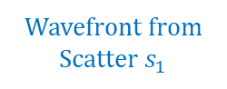
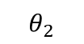
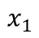
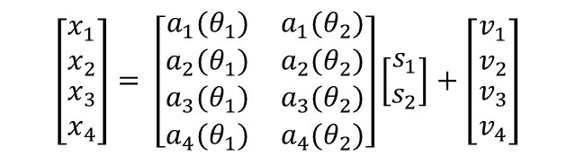
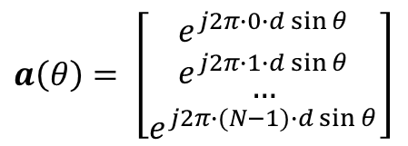
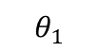
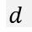
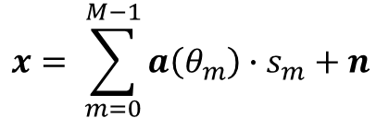
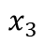
Antenna Array: A Mathematical Data Model
Wavefront from Scatter $s_{1}$
boresight
Wavefront from Scatter $s_{2}$
Consider a Uniform Linear Array (ULA) in 1-D Angle Space
All elements are identical in terms of radiation pattern, orientation, etc.
The expression for the complex array output, x , due to the incidence of M far-field signals (sources) is
$$θ_{1}$$
$$θ_{2}$$
Complex Signal Coefficient
$$d⁡$$
$$x_{1}$$
$$x_{2}$$
$$x_{3}$$
$$x_{4}$$
Noise Vector
$$x= \sum_{m=0}^{M−1}{a\left(θ_{m}\right)∙s_{m}+n}$$
Matrix Notation of Received Signal of Array
Uniform Element Spacing
(as a multiple of λ)
$$\left[\begin{matrix}\begin{matrix}x_{1} \\ x_{2}\end{matrix} \\ \begin{matrix}x_{3} \\ x_{4}\end{matrix}\end{matrix}\right]= \left[\begin{matrix}\begin{matrix}\begin{matrix}a_{1}(θ_{1}) & a_{1}(θ_{2})\end{matrix} \\ \begin{matrix}a_{2}(θ_{1}) & a_{2}(θ_{2})\end{matrix}\end{matrix} \\ \begin{matrix}\begin{matrix}a_{3}(θ_{1}) & a_{3}(θ_{2})\end{matrix} \\ \begin{matrix}a_{4}(θ_{1}) & a_{4}(θ_{2})\end{matrix}\end{matrix}\end{matrix}\right]\left[\begin{matrix}s_{1} \\ s_{2}\end{matrix}\right]+\left[\begin{matrix}\begin{matrix}v_{1} \\ v_{2}\end{matrix} \\ \begin{matrix}v_{3} \\ v_{4}\end{matrix}\end{matrix}\right]$$
where
Incident Angle
$a\left(θ\right)= \left[\begin{matrix}\begin{matrix}e^{j2π∙0∙d\sin{θ}} \\ e^{j2π∙1∙d\sin{θ}}\end{matrix} \\ \begin{matrix}… \\ e^{j2π∙(N−1)∙d\sin{θ}}\end{matrix}\end{matrix}\right]$
Steering Vector
$$x=As+n$$
⇒
ULA Antenna Receive Data Model is Established

Slide 10
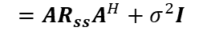
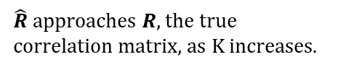

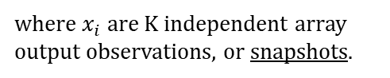

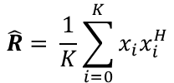
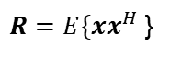
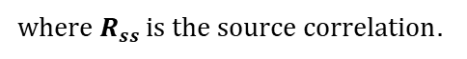
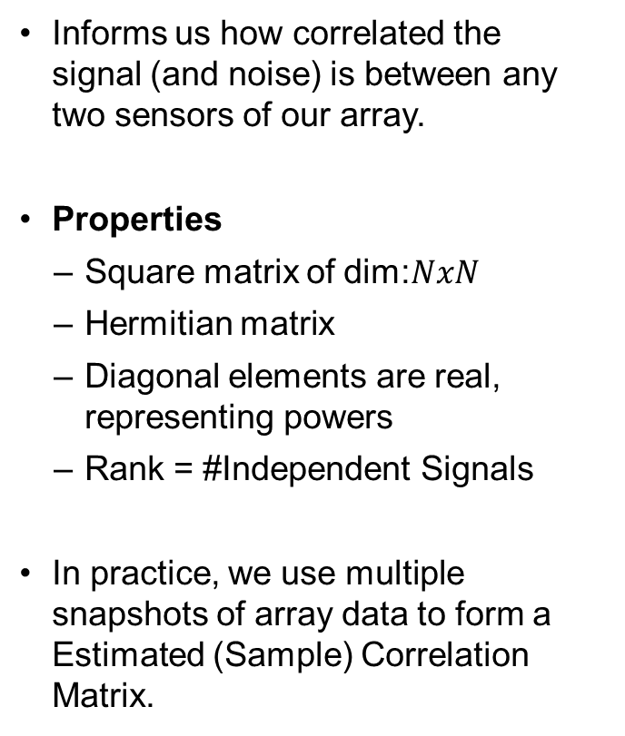

Spatial Correlation Matrix
Informs us how correlated the signal (and noise) is between any two sensors of our array.
Properties
Square matrix of dim:$NxN$
Hermitian matrix
Diagonal elements are real, representing powers
Rank = #Independent Signals
In practice, we use multiple snapshots of array data to form a Estimated (Sample) Correlation Matrix.
Consider a sample of the array output as
$$x= \sum_{m=0}^{M−1}{a\left(θ_{m}\right)∙s_{m}+n} =(As+n)$$
True Correlation Matrix
Estimated Correlation Matrix
$$\hat{R}= \frac{1}{K}\sum_{i=0}^{K}{x_{i}x_{i}^{H}}$$
$R=E\{xx^{H}$}
$$=E\{\left(As+n\right){\left(As+n\right)}^{H}\}$$
$$=E\{As{\left(As\right)}^{H}+Asn^{H}+n{\left(As\right)}^{H}$$
$+nn^{H}\}$
where $x_{i}$ are K independent array output observations, or snapshots.
$$=AR_{ss}A^{H}+σ^{2}I$$
$\hat{R}$ approaches $R$, the true correlation matrix, as K increases.
where $R_{ss }is the source correlation.$
Ergodicity
Spatial Correlation Matrices are Important for Array Signal Processing

Slide 11
Direction of Arrival Estimation
Methods for

Slide 12
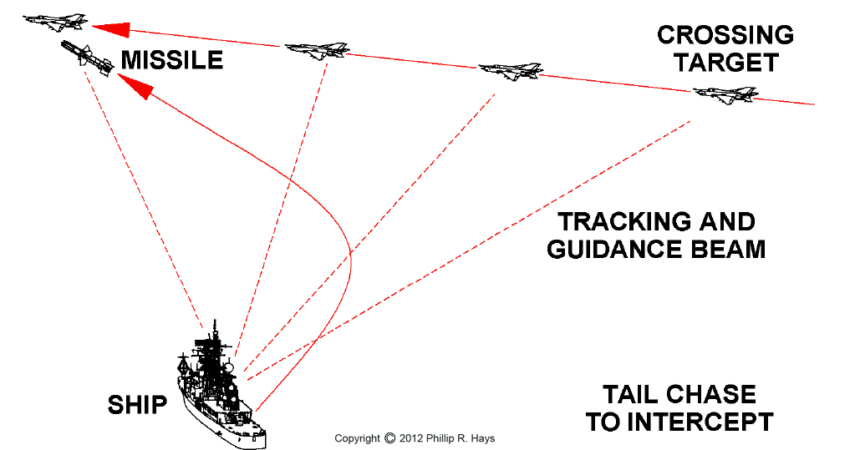
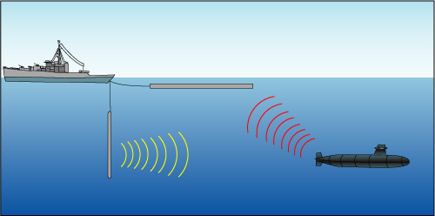
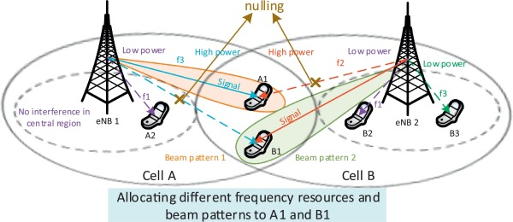
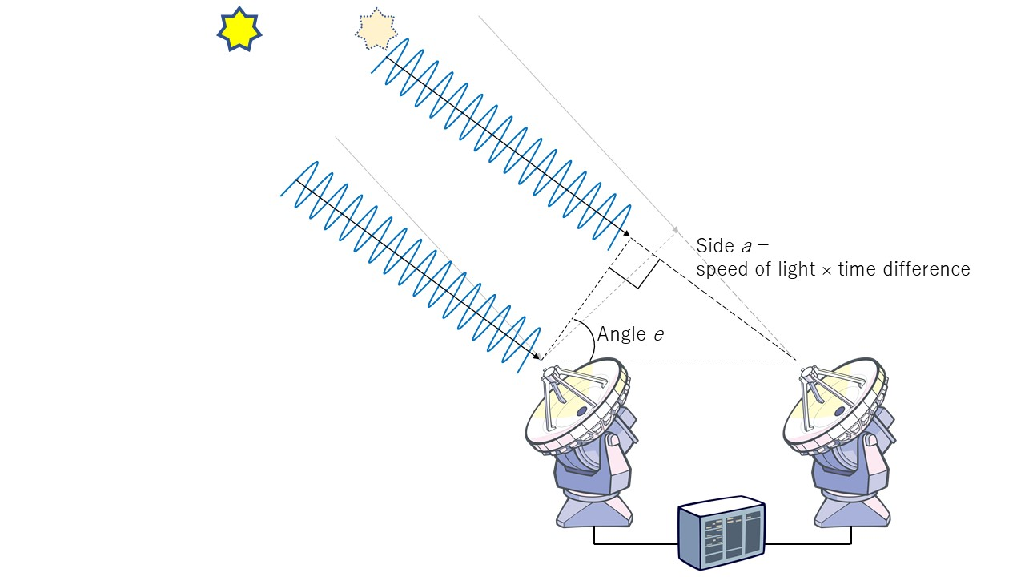
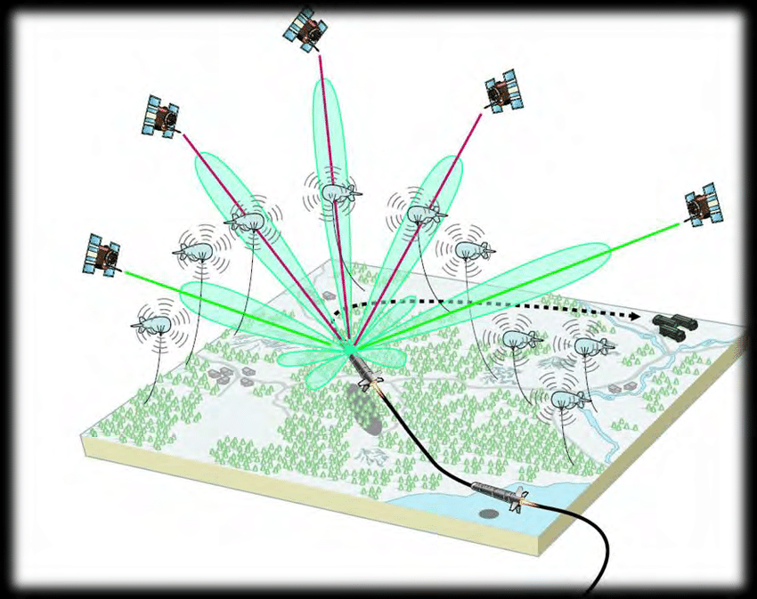
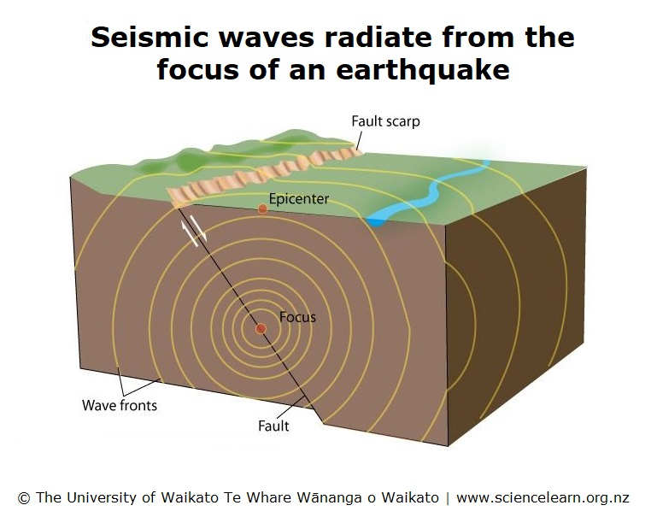
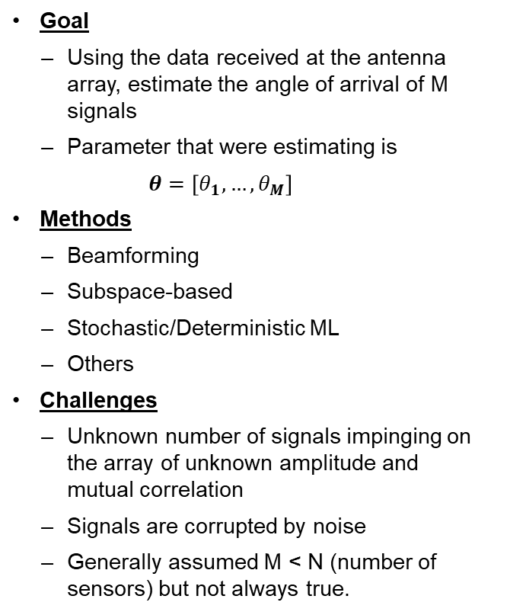
DoA Estimation: Importance and Practical Application
Goal
Using the data received at the antenna array, estimate the angle of arrival of M signals
Parameter that were estimating is
$$θ=\left[θ_{1}, …,θ_{M}\right]$$
Methods
Beamforming
Subspace-based
Stochastic/Deterministic ML
Others
Challenges
Unknown number of signals impinging on the array of unknown amplitude and mutual correlation
Signals are corrupted by noise
Generally assumed M < N (number of sensors) but not always true.
Applications of Direction Finding in Various Domains
Radar
Sonar
Wireless Communications
Radio Astronomy
Navigation
Seismology
DoA Estimation is Used Across Numerous Domains, Several Approaches to Estimation

Slide 13
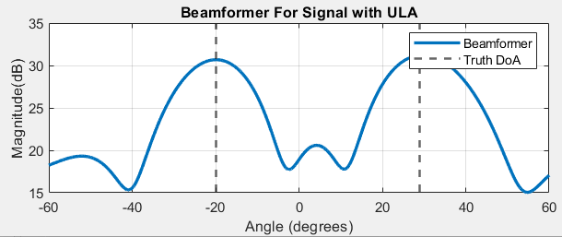
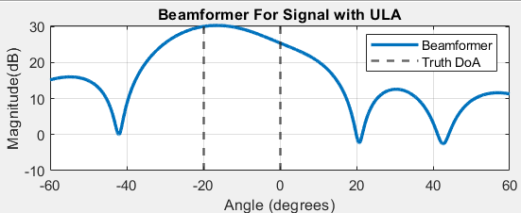
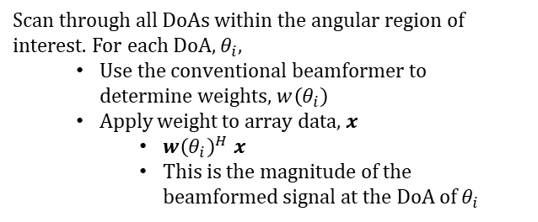
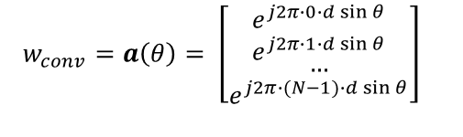
Conventional Beamforming
Performing Beamforming for DoA Estimation
Theory
Beamforming is an operation that creates a spatial filter; it filters out signals from all directions except the desired one.
Used to
Increase SNR of desired signals
Null out interferers
Shape beam patterns
Basic DoA Estimation
Involves choosing weight vector,w , that maximize array gain in intended direction.
DoA Estimation is performed by applying chosen weight vector to array data for all DoAs of interest.
Limitations
Resolution is tied to beamwidth of antenna. Can't resolve multiple sources within beamwidth.
Doesn’t work well when noise is high.
Scan through all DoAs within the angular region of interest. For each DoA, $θ_{i}$,
Use the conventional beamformer to determine weights, $w\left(θ_{i}\right)$
Apply weight to array data, $x$
${w\left(θ_{i}\right)}^{H}$ $x$
This is the magnitude of the beamformed signal at the DoA of $θ_{i}$
Determining Weight Vector
We need the weight vector to
Adjust the phases of the array data so that the signal constructively adds up in a desired direction
Have a magnitude of 1
The steering vector satisfies these conditions!
Beamformer for Two Well-Separated Sources*
Sources are Resolvable
$$w_{conv}=a\left(θ\right)= \left[\begin{matrix}\begin{matrix}e^{j2π∙0∙d\sin{θ}} \\ e^{j2π∙1∙d\sin{θ}}\end{matrix} \\ \begin{matrix}… \\ e^{j2π∙(N−1)∙d\sin{θ}}\end{matrix}\end{matrix}\right]$$
Beamformer for Two Closely-Separated Sources*
Sources are Unresolvable
* Using a 6elem. ULA
Simple Approach to DoA Estimation, Poor Resolution

Slide 14
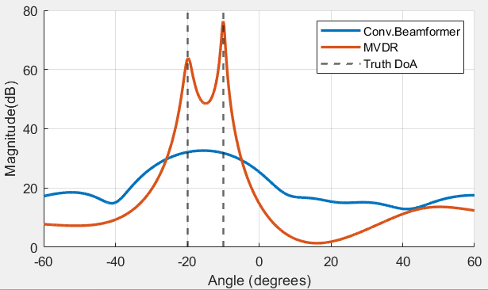
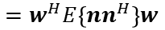

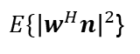









MVDR: Minimum Variance Distortionless Response
Determining MVDR Beamformer Weight Vector
Performing MVDR Beamforming for DoA Estimation
Also known as the Capon DoA Estimator
Can be used for both beamforming and DoA
Scans an MVDR beam over the angular region of interest
A form of adaptive beamforming
Can resolve sources more closely than a conventional beamformer
Example of Superresolution
Limitations
Very sensitive to sensor errors
Has a lower spatial resolution than MUSIC
Using Beamformer Weights: Scan through all DoAs within the angular region of interest. For each DoA, $θ_{i}$, apply the MVDR weights
${w_{MVDR}\left(θ_{i}\right)}^{H}$ $x$
Using Spectral Approximation: A simplified expression for the power spectrum generated by using MDVR weights is
$P_{MVDR}\left(θ_{i}\right)$ $= \frac{1}{{a(θ_{i})}^{H}R^{−1}a(θ_{i})}$
$$y=w^{H}x$$
$$=w^{H}\left(as+n\right)$$
$$=sw^{H}a+w^{H}n$$
Gain = 1
Minimize Variance Or Expected Value of Power
$E\{{\left|w^{H}n\right|}^{2}$}
$$=w^{H}E\left\{nn^{H}\right\}w$$
$$=w^{H}R_{nn}w$$
Comparing MVDR to Conventional Beamforming*
Noise Correlation Matrix
In practice, $\hat{R}$ is used instead of $R_{nn}$
$$Optimization Problem:Determine the beamforming$$
$$weights such that$$
$$\min_{w}{{ w}^{H}\hat{R}w}$$
subject to
$$w^{H}a=1$$
$$Solving gives us$$
$$w_{MVDR}=\frac{{\hat{R}}^{−1}a}{a^{H}{\hat{R}}^{−1}a}$$
* Using a 6elem. ULA
An Adaptive Beamformer With Improved Resolution Compared to Conventional Beamforming

Slide 15








MUSIC: Multiple Signal Classification
Theory
All N eigenvectors of $\hat{R}$ $\left\{q_{1}, q_{2}, …, q_{M}\right\}$are orthogonal
The $N\left(\#sensors\right)−M\left(\#signal\right)$ smallest eigenvalues are identical. Their corresponding eigenvectors form the noise subspace, $U_{N}$.
The eigen vectors corresponding to the remaining M largest eigenvalues form the signal subspace, $U_{S}$.
$U_{S}$ is orthogonal to $U_{N}$ ($U_{S}$ $⊥$ $U_{N}$)
If a signal vector $a∈U_{S}$, then $a⊥U_{N}$
To measure the orthogonality of $a$ w.r.t $U_{N}$ , MUSIC defines the squared norm $d^{2}$
$d^{2}= {\left\|U_{N}^{H}a\right\|}^{2}= a^{H}U_{N}U_{N}^{H}a$
Orthogonality is satisfied when $d^{2}=$ 0
$U_{N}U_{N}^{H}$ is the noise projection matrix
MUSIC defines its angular estimation function (pseudo-spectrum) as
$P_{MU}\left(a\right)=$ $\frac{1}{a^{H}U_{N}U_{N}^{H}a}$
where $a\left(θ\right)$ is the candidate steering vector for a particular DoA.
The locations of the peaks of $P_{MU}$ give us the DoA estimates.
Limitations
K (#snapshots) > N (dim.of $\hat{R}$ / # of sensors)
For a sample correlation matrix, $\hat{R}$, the eigendecomposition provides us the diagonal eigenvalue matrix $Λ$ and the square eigenvector matrix Q
$$\hat{R}= \frac{1}{K}\sum_{i=0}^{K}{x_{i}x_{i}^{H}}$$
$$\hat{R}=eig\left(\hat{R}\right)=USU^{H}$$
Eigenvalues of Sample Correlation Matrix
Eigenvectors of Sample Correlation Matrix
$$U= \left[\begin{matrix}\begin{matrix}u_{11} & u_{12} \\ u_{21} & u_{22}\end{matrix} & \begin{matrix}u_{13} & \begin{matrix}u_{13} & u_{13} & u_{13}\end{matrix} \\ u_{23} & \begin{matrix}u_{23} & u_{23} & u_{23}\end{matrix}\end{matrix} \\ \begin{matrix}u_{31} & u_{32} \\ \begin{matrix}u_{41} \\ u_{51} \\ u_{61}\end{matrix} & \begin{matrix}u_{42} \\ u_{52} \\ u_{62}\end{matrix}\end{matrix} & \begin{matrix}u_{33} & \begin{matrix}u_{33} & u_{33} & u_{33}\end{matrix} \\ \begin{matrix}u_{43} \\ u_{53} \\ u_{63}\end{matrix} & \begin{matrix}\begin{matrix}u_{43} \\ u_{54} \\ u_{64}\end{matrix} & \begin{matrix}u_{43} \\ u_{55} \\ u_{65}\end{matrix} & \begin{matrix}u_{43} \\ u_{56} \\ u_{66}\end{matrix}\end{matrix}\end{matrix}\end{matrix}\right]$$
Signal Subspace
$$U_{S}$$
Noise Subspace
$$U_{N}$$
Note: the sample correlation matrix, $\hat{R}$, contains information of both the Signal and Noise Subspace
$$\hat{R}= U_{S}S_{s}U_{S}^{H}+U_{N}S_{N}U_{N}^{H}$$
Exploitation of Orthogonality of Signal Vectors to Noise Subspace Allows for Accurate Estimation

Slide 16








MUSIC: Algorithm and Limitations
Algorithm Description
Advantages
Perform an eigen decomposition of $\hat{R}.$
Determine the size of the signal and noise subspace by looking at the eigenvalues (AIC/MDL Algorithms).
Determine the noise subspace U_{N.}
Search over steering vectors to find ones which are orthogonal to the noise subspace (find peaks of $P\left(θ\right)$).
$$\hat{R}=USU^{H}$$
Exploits orthogonality of noise subspace and signal vectors
Has the superresolution ability, i.e. estimating multiple sources within the mainlobe of the antenna pattern
Converges to true DoA as #snapshots increases
Dominant eigenvalues corresponding to number of signals ($M$)
$$\{λ_{i}\}=λ_{1},...,λ_{M},σ_{1}^{2},...σ_{N−M}^{2}$$
$N−M$ eigenvalues corresponding to noise
Limitations
$$U_{N}=U\left(:,M+1:N\right)$$
Requires estimation of number of signals
Assumes #sources < #sensors ( M < N )
Assumes sources to be uncorrelated
$$P\left(θ\right)=\frac{1}{a{\left(θ\right)}^{H}\left(U_{N}U_{N}^{H}\right)a\left(θ\right)}$$
MUSIC is Powerful But Has Its Limitations

Slide 17
Neural Networks for DoA Estimation

Slide 18







Overview of Neural Networks for DoA Estimation
Neural networks are universal approximators
Given a continuous function $f(x)$ and some $ε>0$, there exists a neural network $g(x)$ with a single hidden layer such that $∀x, \left|f\left(x\right)−g(x)\right|< ε$
Deep networks with many layers and have shown strong, potentially unlimited discriminative power
Utilizing N.N.s for DoA Estimation
A mapping can be defined
between the DoA values $θ=\left[θ_{1}, …,θ_{M}\right] ϵ$ $Θ$ and the array data x $ϵ Σ$
Basic Perceptron (Neuron) Operation
$y=f(Wx+b)$
$$G : Θ ⟶ Σ$$
Example of a Deep Neural Network
The DoA Estimation problem is defined as the retrieval $θ$ starting from the knowledge of x , as seen in the inverse mapping
$$F : Σ ⟶Θ$$
AI/ML, more specifically Neural Networks, can be used to estimate this inverse mapping.
Neural Networks Have Wide Applicability in Signal Processing

Slide 19

Model Based Deep Learning
Model Based Deep Learning Combines The Benefits of Both Approaches

Slide 20












COSnet: Complex Orthogonal Search Network
This network attempts to loosely replicate the orthogonal search performed by MUSIC to find steering vectors which are orthogonal to the noise subspace.
Comparison of Estimated Spatial Spectrum Made by COSnet Using Surrogate Matrix $X_{N}$vs MUSIC
$$P\left(θ\right)= \frac{1}{{a\left(θ\right)}^{H}\left(U_{N}U_{N}^{H}\right)a(θ)}$$
We will refer to the term $\left(U_{N}U_{N}^{H}\right)$ as $X_{N},$which is the learned surrogate matrix.
$$= \frac{1}{{a\left(θ\right)}^{H}\left(X_{N}\right)a(θ)}$$
Network Architecture
Output
Input
Trainable Layers
Surrogate Matrix
Fixed Layers
$f_{1}\left(Z\right)=$
$f_{2}\left(z\right)=$
$$X_{N}$$
$${a(θ)}^{H}Z a(θ)$$
$${10}^{−q∙abs(z)}$$
Dim:
(N x N x 1)
Dim:
(N x N x 1)
$∀ a\left(θ\right) ε A$
Dim:
($\left|A\right|$ x1)
Sample Correlation Matrix from a N-Element ULA (complex)
Arbitrary number/dimension of hidden layers
Learned Output of Final Hidden Layer
Assess orthogonality against steering vectors in set A
Performs reciprocal operation and converts output to be dB-like
Estimated Spatial Spectrum by Network
COSnet “Learns” a Surrogate Matrix That Behaves Like the Noise Subspace Based Projection Matrix $U_{N}U_{N}^{H}$

Slide 21









MUSIC Algorithm
Output
Input
Surrogate Matrix
$f_{1}\left(Z\right)=$
$f_{2}\left(z\right)=$
$$eig()$$
$$U_{N}U_{N}^{H}$$
$${a(θ)}^{H}Z a(θ)$$
$$1/z$$
Dim:
(N x N x 1)
Dim:
(N x N x 1)
$∀ a\left(θ\right) ε A$
Dim:
($\left|A\right|$ x1)
Sample Correlation Matrix from a N-Element ULA (complex)
Eigendecomposition into
Noise Subspace Based Projection Matrix
Assess orthogonality against steering vectors in set A
$$R= U_{S}S_{s}U_{S}^{H}+U_{N}S_{N}U_{N}^{H}$$
Performs reciprocal operation
Estimated Spatial Spectrum by Algorithm
Network Architecture
Output
Input
Trainable Layers
Surrogate Matrix
Fixed Layers
$f_{1}\left(Z\right)=$
$f_{2}\left(z\right)=$
$$X_{N}$$
$${a(θ)}^{H}Z a(θ)$$
$${10}^{−q∙abs(z)}$$
Dim:
(N x N x 1)
Dim:
(N x N x 1)
$∀ a\left(θ\right) ε A$
Dim:
($\left|A\right|$ x1)
Sample Correlation Matrix from a N-Element ULA (complex)
Arbitrary number/dimension of hidden layers
Learned Output of Final Hidden Layer
Assess orthogonality against steering vectors in set A
Performs reciprocal operation and converts output to be dB-like
Estimated Spatial Spectrum by Network
Comparison of MUSIC Algorithm to Model Based Deep Learning Approach

Slide 22


COSnet: Capabilities
Resolving up to N Sources
MUSIC can theoretically predict up to (N-1) sources for N spatial degrees of freedom( # of antenna elements)
(Left) The learned X_{n} surrogate matrix produced by COSnet shows the ability to resolve up to N sources.
* Using a 4elem. ULA
Utilizing Alternative Input Data
Additional information can be provided to the neural network as input to improve predictive ability
(Right) Providing a Quadricovariance matrix as input to the COSnet showed enhanced resolution of N sources, but did not expand the DoFs.
* Using a 4elem. ULA
AI/ML Surrogate Matrix Has Additional Capabilities and Flexibility in Its Structure/Nature

Slide 23
Restate Problem Statement

Slide 24

Goals for Problem Solvers
Goal 1: Characterize Surrogate Matrix
Goal 2: Derive Additional Surrogate
Matrices
Understand its mathematical properties
Identify relations to MUSIC noise subspace or MVDR inverse matrix.
Determine how surrogate matrix is able to demonstrate enhanced behavior
Exploit and enhance any understood principles of the surrogate matrix.
Leverage surrogate matrices to develop virtual sensor concepts that provide enhanced degrees of freedom
Surrogate Matrices | MVDR | MUSIC | COSnet
 | $${\hat{R}}^{−1}$$ | $$U_{N}U_{N}^{H}$$ | $$X_{N}$$
Various Surrogate Matrices Have Been Covered. Can We Develop A Better One?

Slide 25

Provided Data
Surrogate Matrix Data
Algorithm/Helper Scripts
References
MATLAB script to support analysis of data and methods
Plot Antenna Pattern of ULA
Generate Steering Vectors
Form Array Output Data
Demonstration Algorithms
Conventional Beamformer
MVDR Beamformer
MUSIC
Load Surrogate Matrix Data and Plot Spatial Spectrum.
Papers on MUSIC and other Subspace Based Techniques
R. Schmidt, “A signal subspace approach to multiple emitter location and spectral estimation”,
2. R. H. Roy, “ESPRIT – Estimation of Signal Parameters via Rotational Invariance Techniques”,
3. Y. Hua and T. K. Sarkar, “Matrix Pencil Method for Estimating Parameters of Exponentially damped/Undamped Sinusoids in Noise”, IEEE Transactions on ASSP, Vol. 38, No. 5, May 1990
4. T. K. Sarkar and O. Pereira,” Using the Matrix Pencil Method to Estimate the Parameters of a Sum of Complex Exponentials”, IEEE AP Magazine, Vol. 37, No. 1, February 1995.
Papers on Higher Order Statistics and Virtual Array Concepts
B. Porat and B. Friedlander, “Direction finding algorithms based on high-order statistics,” IEEE Trans. Signal Processing, vol. 39, 2016-2024, Sep. 1991.
2. M. C. Dogan and J. M. Mendel, “Applications of cumulants to array processing: I. Aperture extension and array calibration.” IEEE Trans. Signal Proc., vol. 43, pp. 1200-16, May 1995.
3. P. Chevalier, L. Albera, A. Ferreol, and P. Comon, “On the virtual array concept for higher order array processing,” IEEE Trans Signal Processing, vol. 53, pp. 1254-1271, Apr. 2005.
4. P. Chevalier and A. Ferreol, “On the virtual array concept for the fourth-order direction finding problem,” IEEE Trans. Signal Processing, vol. 47, pp. 2592-2595, Sep. 1999.
50 Realizations of Array Data for each source count (1-4) that Includes
$\hat{R} :$Normalized Sample Correlation Matrix
$X_{N}$: Corresponding AI/ML Surrogate Matrix
$θ=\left[θ_{1}, …,θ_{M}\right]$: Truth DoAs of sources
$SNR=\left[{SNR}_{1}, …,{SNR}_{M}\right]$: SNRs of sources
General ULA parameters (ne, d, az_extent)
Continued Support For Providing Any Required Data/Scripts/Information

Slide 26
Questions?
Thank you!

Slide 27







Quadricovariance Matrix
Forming Quadricovariance Matrix
$$for i=1:N$$
$$for j=1:N$$
$$for k=1:N$$
$$for l=1:N$$
$c1=sum( x[i,:]∙{x\left[j,:\right]}^{∗}∙{x\left[k,:\right]}^{∗}∙x[l,:]$ ) / K
$$c2=sum\left( x[i,:]∙{x[j,:]}^{∗} \right)∙{sum( x[k,:]}^{∗}∙x[l,:]\text{)}\text{ / }K^{2}$$
$$c3=sum\left( x[i,:]∙{x[k,:]}^{∗} \right)∙{sum( x[j,:]}^{∗}∙x[l,:]\text{)}\text{ / }K^{2}$$
$$c4=sum\left( x[i,:]∙x[l,:]\right)∙{sum( x[j,:]}^{∗}∙{x[k,:]}^{∗}\text{)}\text{ / }K^{2}$$
$$Q_{c}\left[ N\left(i−1\right)+k N∗\left(l−1\right)+j \right]=c1 −c2 −c3 −c4$$
$$anti=fliplr(diag\left(ones\left(N^{2}\right)\right))$$
$$Q_{c,B}=anti ∗Q_{c}^{∗} ∗anti$$
$Q_{c,FB}=(Q_{c}$ + $Q_{c,B}$) / 2

Slide 28


Slide 29


Slide 30


